Slide 1
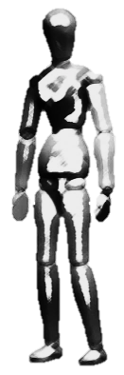


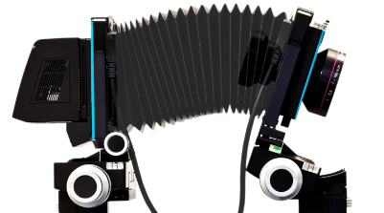
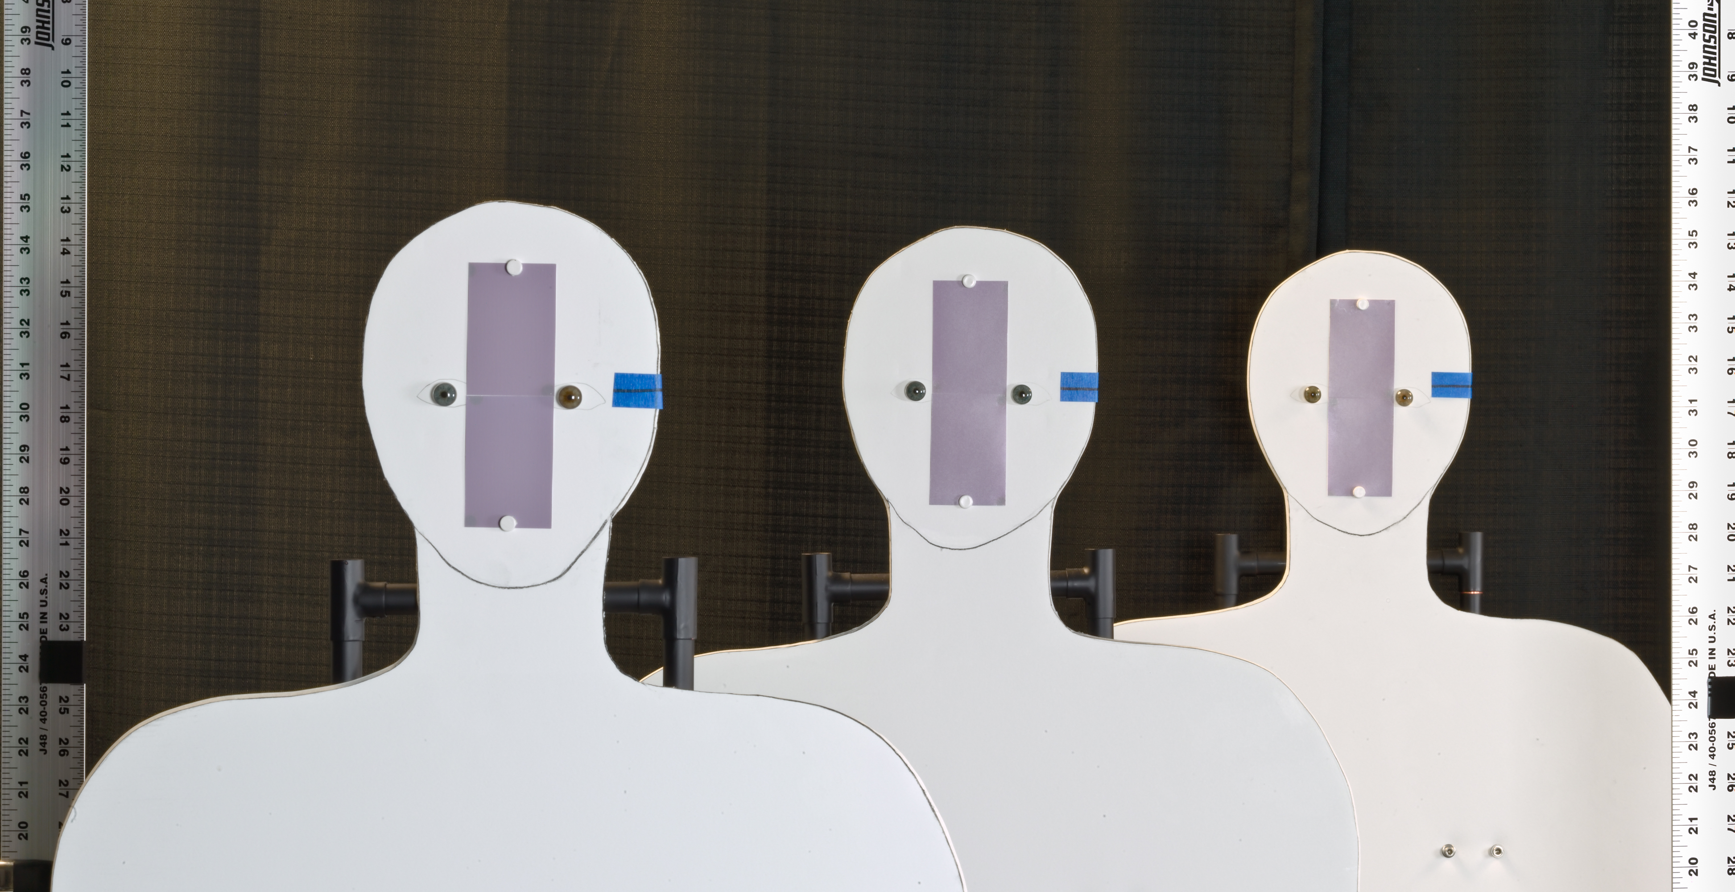
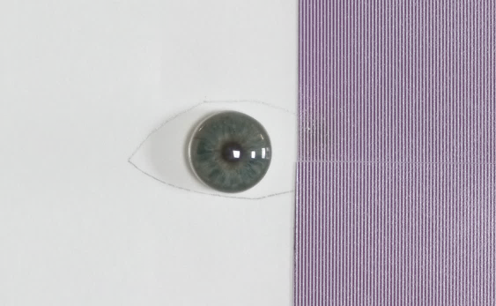
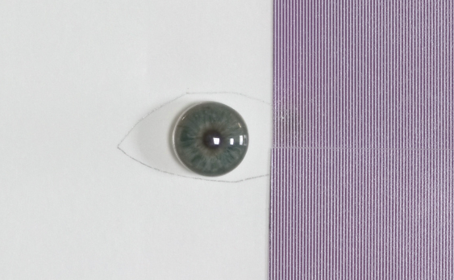
Demonstration of capture volume improvement using a Scheimpflug camera
0.61 m
0.61 m
4.038 m
Setup
rear
middle
180 mm, F/8
near
Artificial iris
Ø 11 mm
Camera’s view
Pattern (2 lp/mm)
mm

Slide 2
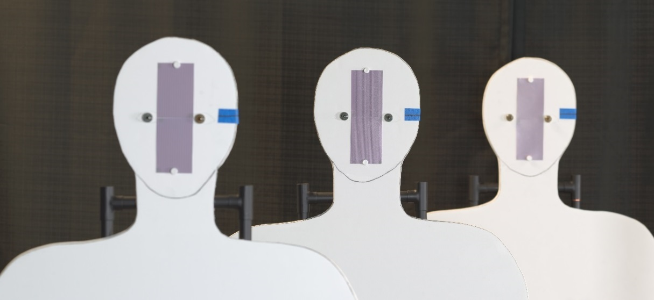
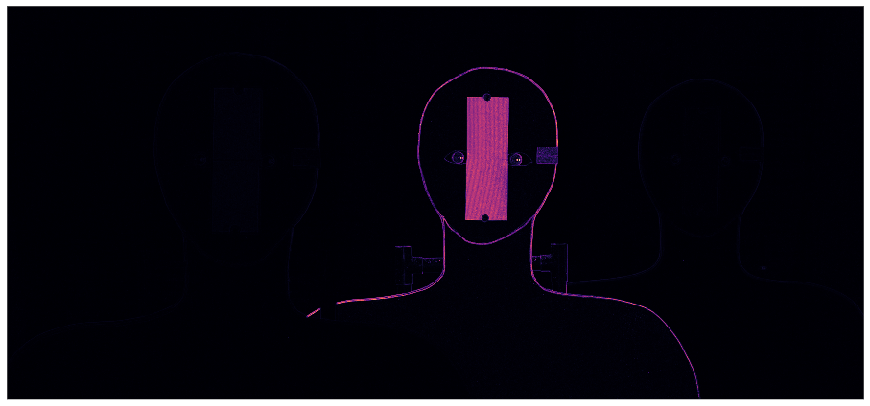
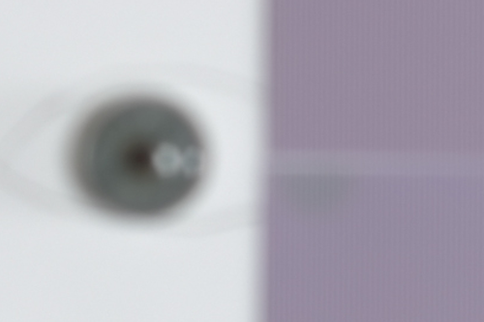
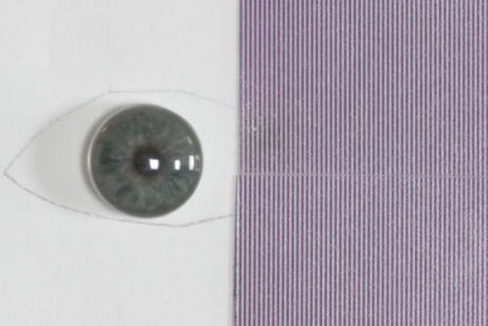
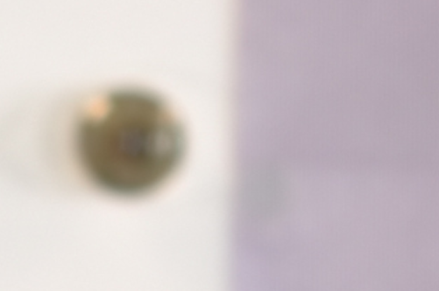
Conventional image with focus on the middle cutout at optimum aperture
Aperture: F/8 Exposure time: 0.77 sec
3.43 m
4.04 m
4.65 m
Focus measure
Notes:
Mention that the patches has been scaled differently to match ???

Slide 3
Strategy
180 mm, F/8 lens tilted b/w -16° & -19° in increments of 0.5° about the entrance pupil center

Slide 4
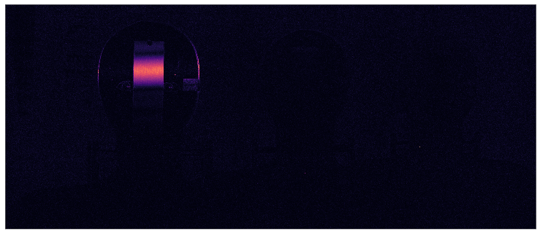
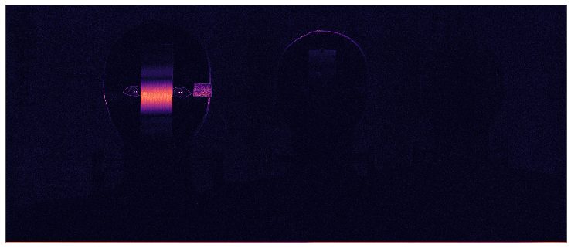
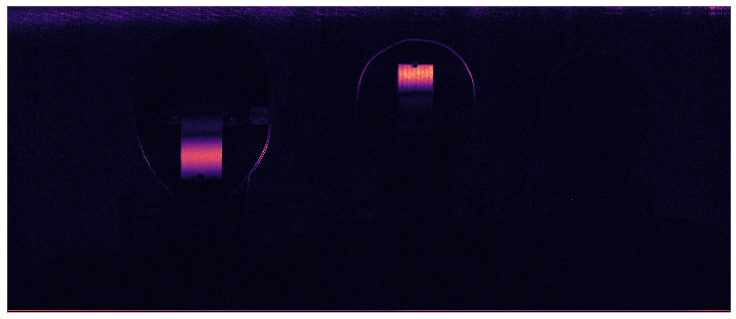
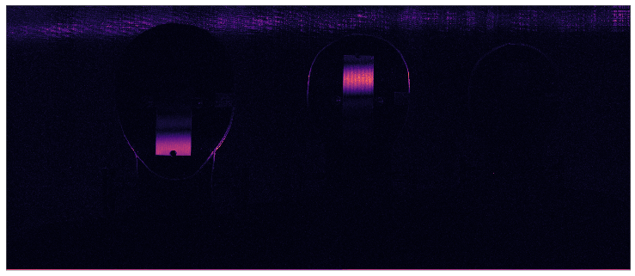
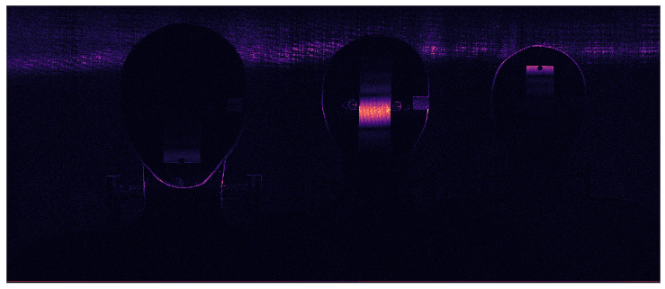
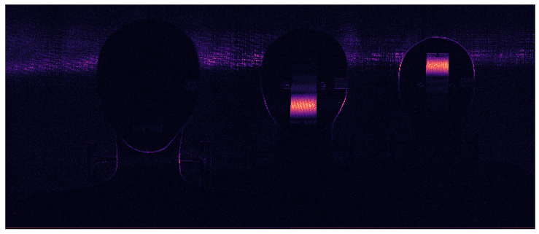
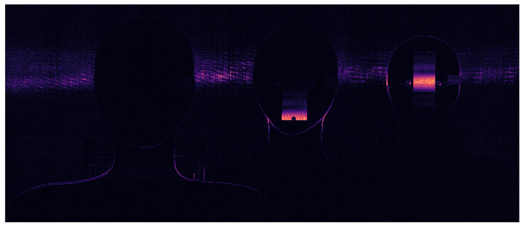
In-focus regions detected in the registered focal stack images using LoG filter
180 mm, F/8 lens tilted b/w -16° & -19° in increments of 0.5° about the entrance pupil center

Slide 5
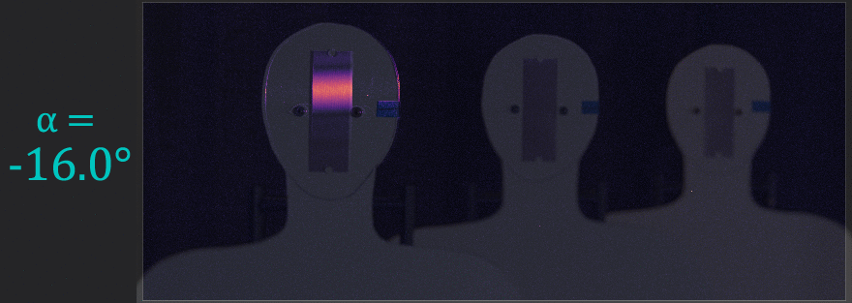
In-focus regions overlaid on corresponding intensity images
Angular scan of the depth of field in the object space

Slide 6
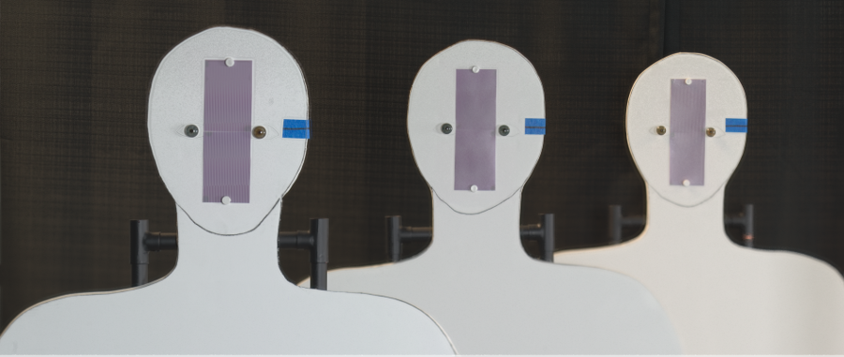
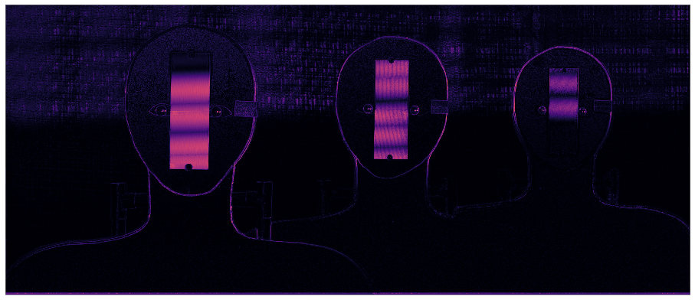
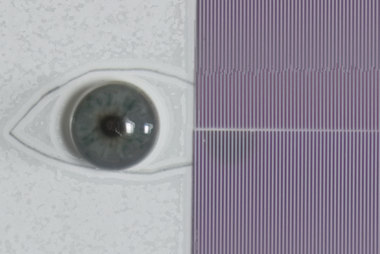
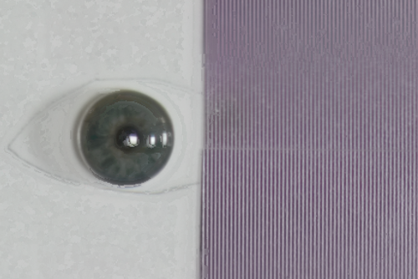
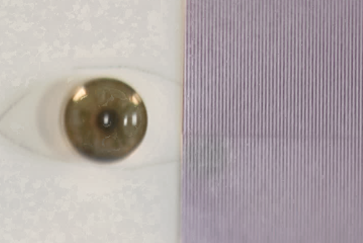
Composite image showing depth of field beyond 1.2 meters
Aperture: F/8 (each image) Total exposure time: 5.4 sec
3.43 m
4.04 m
4.65 m
Focus measure

Slide 7
Angular focus stacking vs. conventional image capture @ F/8
Near (3.43 m )
Middle (4.04 m )
Far (4.65 m )
Conventional @ F/8
Angular Focus Stacking
Notes:
Mention that the patches has been scaled differently to match ???

Slide 8
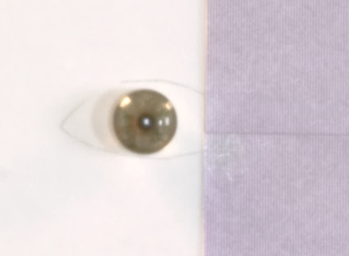
Angular focus stacking vs. conventional image capture @ F/22
Near (3.43 m )
Middle (4.04 m )
Far (4.65 m )
Conventional @ F/22
Angular Focus Stacking
Notes:
Since the main comparision here is for the total time … I can probably scale the images of the eye patches

